Slide 1

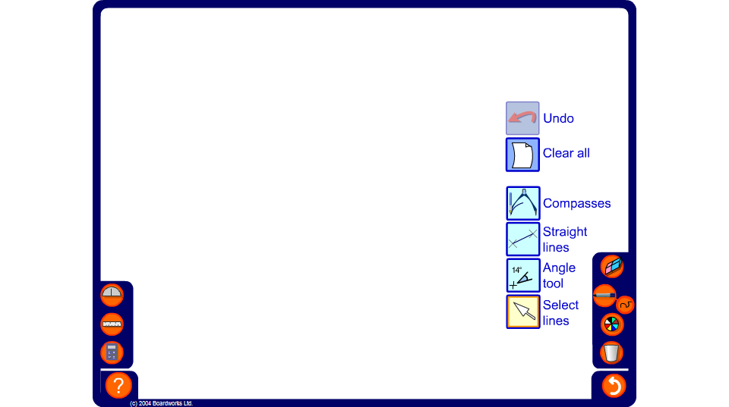


Estimating angles
Notes:
Discuss the importance of being able to estimate angles when measuring them. It is the best way to check that we haven’t made a mistake by, for example, reading the wrong scale on the protractor.
Pupils should know what a 45° degree angle looks like because it is half of a right angle. They can then use multiples of 45° and 90° as the basis for their estimation.
Ask pupils to construct a table with three headings: estimate, actual and difference.
Use the straight line tool to draw an angle on the board. Ask pupils to estimate the size of the required angle and to write it down under the column headed ‘Estimate’. Reveal the size of the angle using the angle button. Ask pupils to write this down under the column headed ‘Actual’. They can then work out the difference between their estimate and the actual size of the angle.
Modify the angle by dragging the end points of one of the lines. Repeat the activity for several more angles.
At the end, ask pupils to add up the total of their column of differences. Find out who has the lowest total and congratulate them.

